Slide 1
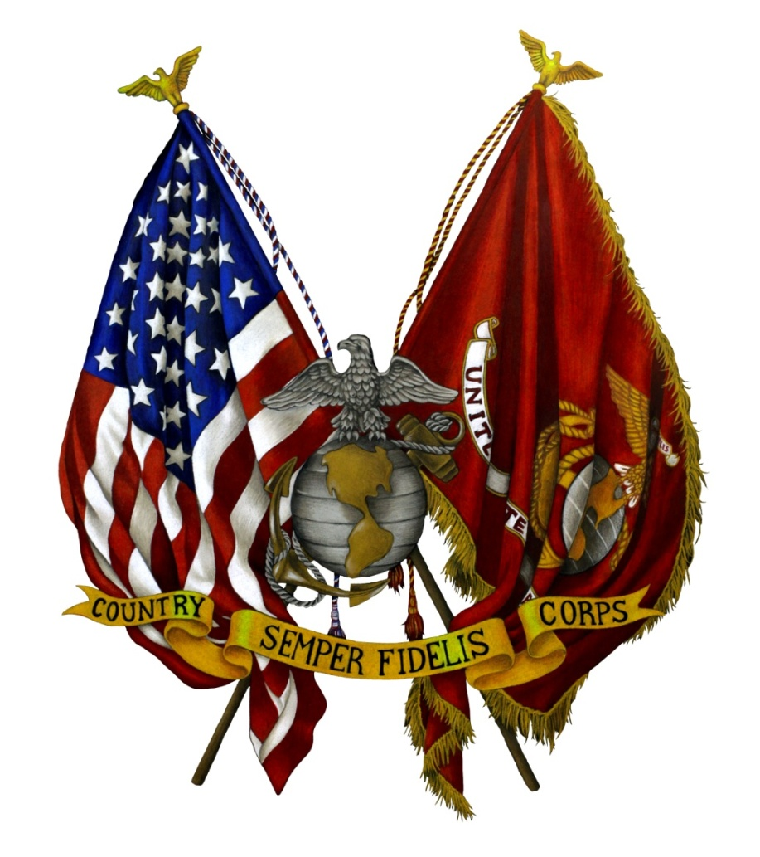

Welcome to the
Retirement Ceremony
of
Rank
Name M. Name
Honor – Courage - Commitment
XX Month 20XX
Location
Semper Fidelis

Slide 2

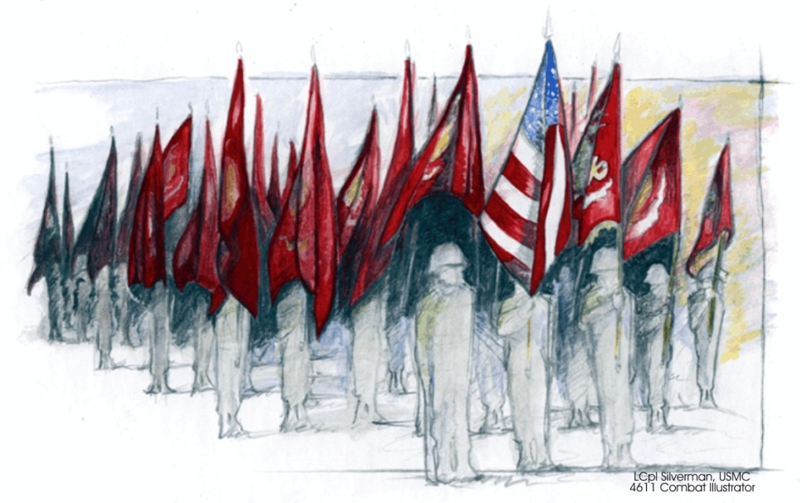
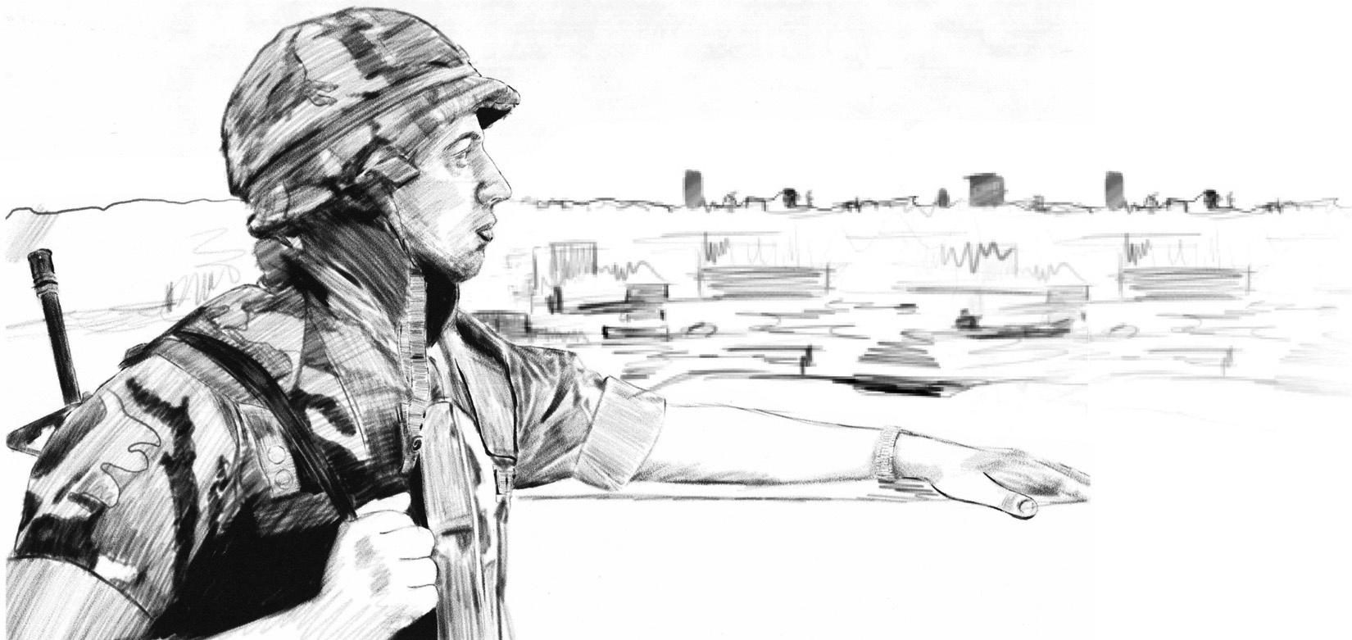
Sequence of Events
Marines’ Hymn
Invocation
National Anthem
Attention to Orders
Award Presentation
Retirement of ___________________
Marines’ Hymn
Dismissal
Reception
From the Halls of Montezuma
To the shores of Tripoli,
We fight our country's battles
In the air, on land and sea.
First to fight for right and freedom,
And to keep our honor clean,
We are proud to claim the title of
United States Marines.
Our flag's unfurled to every breeze
From dawn to setting sun;
We have fought in every clime and place
Where we could take a gun.
In the snow of far-off northern lands
And in sunny tropic scenes,
You will find us always on the job
The United States Marines.
Here's health to you and to our Corps
Which we are proud to serve;
In many a strife we've fought for life
And never lost our nerve.
If the Army and the Navy
Ever look on Heaven's scenes,
They will find the streets are guarded by
United States Marines.

Slide 3
The Marine’s Prayer
Welcome
Almighty Father whose command is overall and whose love never fails, make me aware of Thy presence and obedient to Thy will. Keep me true to my best self, guarding me against dishonesty in purpose and deed and helping me to live so that I can face my fellow Marines, my loved ones, and Thee without shame or fear. Protect my family. Give me the will to do the work of a Marine and to accept my share of responsibilities with vigor and enthusiasm. Grant me the courage to be proficient in my daily performance. Keep me loyal and faithful to my superiors and to the duties my country and the Marine Corps have entrusted to me. Make me considerate of those committed to my leadership. Help me to wear my uniform with dignity and let it remind me daily of the traditions which I must uphold. If I am inclined to doubt, steady my faith; if I am tempted, make me strong to resist; if I should miss the mark, give the courage to try again. Guide me with the light of truth and grant me wisdom by which I may understand the answers to my prayer.
Welcome to the Retirement Ceremony
Of
Rank
First M. Last
Who will Retire after XX years
Of faithful service
BIO Photo Here
Amen
01 Month 19XX – 01 Month 20XX

Slide 4


Rank Name M. Name
Rank Name M. Name
BIO Photo Here
United States Marine Corps
BIO Photo Here
United States Marine Corps
Rank Marine currently serves as the Commanding Officer of Unit and Command and previously the Commanding Officer of Unit as well as the Officer-in-charge of certain events. Rank Marine currently serves as the Commanding Officer of Unit and Command and previously the Commanding Officer of Unit as well as the Officer-in-charge of certain events. Rank Marine currently serves as the Commanding Officer of Unit and Command and previously the Commanding Officer of Unit as well as the Officer-in-charge of certain events. Rank Marine currently serves as the Commanding Officer of Unit and Command and previously the Commanding Officer of Unit as well as the Officer-in-charge of certain events.
Rank Marine currently serves as the Commanding Officer of Unit and Command and previously the Commanding Officer of Unit as well as the Officer-in-charge of certain events. Rank Marine currently serves as the Commanding Officer of Unit and Command and previously the Commanding Officer of Unit as well as the Officer-in-charge of certain events. Rank Marine currently serves as the Commanding Officer of Unit and Command and previously the Commanding Officer of Unit as well as the Officer-in-charge of certain events. Rank Marine currently serves as the Commanding Officer of Unit and Command and previously the Commanding Officer of Unit as well as the Officer-in-charge of certain events.
Rank Marine currently serves as the Commanding Officer of Unit and Command and previously the Commanding Officer of Unit as well as the Officer-in-charge of certain events. Rank Marine currently serves as the Commanding Officer of Unit and Command and previously the Commanding Officer of Unit as well as the Officer-in-charge of certain events.
Rank Marine currently serves as the Commanding Officer of Unit and Command and previously the Commanding Officer of Unit as well as the Officer-in-charge of certain events. Rank Marine currently serves as the Commanding Officer of Unit and Command and previously the Commanding Officer of Unit as well as the Officer-in-charge of certain events. Rank Marine currently serves as the Commanding Officer of Unit and Command and previously the Commanding Officer of Unit as well as the Officer-in-charge of certain events. Rank Marine currently serves as the Commanding Officer of Unit and Command and previously the Commanding Officer of Unit as well as the Officer-in-charge of certain events.
Rank Marine currently serves as the Commanding Officer of Unit and Command and previously the Commanding Officer of Unit as well as the Officer-in-charge of certain events. Rank Marine currently serves as the Commanding Officer of Unit and Command and previously the Commanding Officer of Unit as well as the Officer-in-charge of certain events. Rank Marine currently serves as the Commanding Officer of Unit and Command and previously the Commanding Officer of Unit as well as the Officer-in-charge of certain events. Rank Marine currently serves as the Commanding Officer of Unit and Command and previously the Commanding Officer of Unit as well as the Officer-in-charge of certain events.
Rank Marine currently serves as the Commanding Officer of Unit and Command and previously the Commanding Officer of Unit as well as the Officer-in-charge of certain events. Rank Marine currently serves as the Commanding Officer of Unit and Command and previously the Commanding Officer of Unit as well as the Officer-in-charge of certain events.

Slide 5
Instructions
Fill out cover page information
2. Fill out welcome page and bios
Insert photos as required
Print Page 1 & 2 front and back then print pages 3 & 4 front and back

